Slide 1
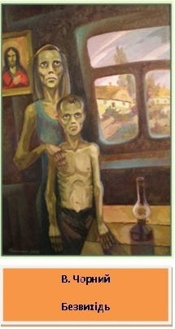
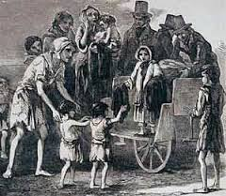
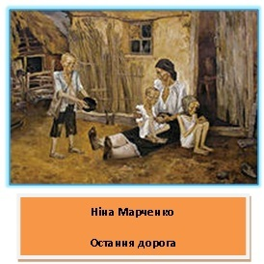
Irish and Ukrainian Literary Treatments
of the Famines
Prof. Ph. D. Oksana Weretiuk
University of Rzeszow, Poland

Slide 2
The Great Famine, Irish Potato Famine (an Gorta Mór or an Drochshaol), 1845-1849
Ukrainian “Голодомор” (the literal definition of the word “holodomor” is “death by forced starvation”, “hunger-extermination”), 1932-1933

Slide 3
The meaning of the Great Famine has been contested by historians from the 1850s to the present day. Three main positions are put forward:
1) nationalistic, i.e. the Great Famine as the ultimate case of British oppression of the Irish people, a view of those who passionately struggled for Irish independence;
2) revisionist, as that of the Institute of Historical Research in London of 1950-60s and of R. Dudley Edwards and T. Desmond Williams (eds.), The Great Famine: Studies in Irish History 1845-52, 1956, which explain that Famine was not the fault of the British Government, and that the disaster has a more organic than deliberate origin;
3) post-revisionist, since the 1980s, saying that “Food availability was a problem; nobody wanted the extirpation of the Irish as a race” (Ó Gráda).

Slide 4
1. The first Famine generation: Irish 1845-1900 Ukrainian 1932-1990
2. Next post-Famine generations: Irish 1991- 2019; Ukrainian: 1991-2019

Slide 5
Famine fiction,1846-1921 (compiled by Marguérite Corporaal, Christopher Cusack and Lindsay Janssen
‘An Irishman’. Poor Paddy’s Cabin; or, Slavery in Ireland (London: Wertheim and MacIntosh, 1854).
Armstrong, M. M. “The Piper’s Gift. A Tale of the Irish Famine”. McGee’s Illustrated Weekly 1 (1876–7).
Barlow, Jane. Kerrigan’s Quality (New York: Dodd, Mead and Co., 1894).
Barlow, Jane. “The Keys of the Chest.” A Creel of Irish Stories (London: Methuen and Co., 1897), 1-96.
Barry, William Francis. The Wizard’s Knot (London: T. Fisher Unwin, 1901).
Berens, Louise. Steadfast unto Death: A Tale of the Irish Famine of To-day (London: Remington and Co, 1880).
Berry, James. Tales of the West: Recollections of My Early Boyhood. Mayo News, 1910-13.
Birmingham, G.A. [James Owen Hannay] Minnie’s Bishop and Other Stories (New York: Hodder and Stoughton, 1915).
Bowles, Emily. Irish Diamonds; or the Chronicles of Peterstown (London: Thomas Richardson and Son, 1864).
Brennan, John. Erin Mor; The Story of Irish Republicanism (San Francisco: P.M.Diers and Co., 1892).
Brew, Margaret. The Chronicles of Castle Cloyne (London: Chapman and Hall, 1885).
‘Canada West’. Tim Doolan; or the Irish Emigrant (London: Partridge, 1869).
‘Canada West’. Tim Doolan; or the Irish Emigrant (London: Partridge, 1869).
Cannon, Charles. Bickerton; or the Immigrant’s Daughter (New York: P. O’Shea, 1855).
Carleton, William. The Black Prophet: A Tale Of Irish Famine (London and Belfast: Simms and M’Intyre, 1847).
Carleton, William. The Squanders of Castle Squander (London: Office of the Illustrated London Library, 1852).
Carleton, William. “Owen M’Carthy; or the Landlord and Tenant”, in Alley Sheridan and Other Stories (Dublin: P. Dixon Hardy and Sons, 1857), 113-66.
Cassidy, Patrick.Glenveigh. (Boston: Patrick Donahoe, 1870).
Cheney, Harriet Vaughan. The Literary Garland VIII, no. 2 (1850), 275-81.
Clayton, F. H. (‘An Irishman’). Scenes and Incidents in Irish Life (Montreal: John Lovell, 1884).
Cleary, Kate McPhelim. “The Mission of Kitty Malone.” McClure’s 18 (1901), 88-96.
Clington, Allen H. Frank O’Donnell (Dublin and London: James Duffy, 1861).
Coleman, P.J. “Outrooted.” Rosary Magazine XXVI.6 (June 1905), 559-74.
Coleman, P.J. “O’Carroll’s Quest.” Messenger XXXVII.3 (Mar. 1902), 256-68.
Curtis, Robert. McCormack’s Grudge, in The Irish American, 20-27 September 1862.
Cusack, Margaret Anne (Sister Mary Francis Clare). From Killarney to New York; Or, How Thade Became a Banker. McGee’s Illustrated Weekly, May–Nov. 1877.

Slide 6
“An Irishman”, Mrs Mary Anne Hoare, Asenath Nicholson, James Clarence Mangan, David Power Conyngham, Jane Francesca Elgee, Samuel Ferguson, Aubrey de Vere and William Carleton
Mary Pat Kelly’s Galway Bay (New York, 2009), Charles Egan’s The Killing Snows (Bristol: Silverwood Books, UK 2010), Paul Lynch’s Grace (2018, Little, Brown & Company USA), Paul Sullivan’s A Thousand Tears (Royal Fireworks Press USA 2019).

Slide 7
Ulas Samchuk’s Maria. A Chronicle of a Life, written in emigration in 1933 and first published in Lviv in 1934;
Кострига (1933) by Arkadiy Lyubchenko

Slide 8
Todos’ Osmachka (wrote two famine stories: План до двору (1951), Ротонда душогубців (Rotunda for Murderers), published in 1956)
Theodosy Oshmachka, Red Assassins, Minneapolis: T.S. Denison, 1959. 375 pages. Translation of the novel Rotonda dushohubtsiv
Vasyl Barka, Жовтий принц (The Yellow Prince, 1963) Mykola Ponedilok (short stories)
Olha Mak (a short story Столиця голодного жаху (The Capital of Hungry Horror), a novel Каміння під косою (Stones under the scythe,1973)
preface. Translator's name is not indicated.

Slide 9
Ołeś Janczuk „Femine 33”

Slide 10
In 1990s: Anatoliy Dimarov, Samosud; Yevhen Hutsal, Holodomor; Mykhaylo Potupeiko, У лабетах смерті (1994).
Pavlo Naniyev’s biographical fiction Лозинова труна (Kiev -New York 2003)
Alexander J. Motyl, Sweet Snow. A Novel of the Ukrainian Famine of 1933 (Massachusetts, 2013)
Mykhaylo Brynykh, Хліб із хрящами (2011)

Slide 11
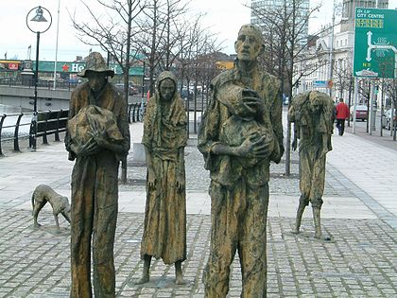
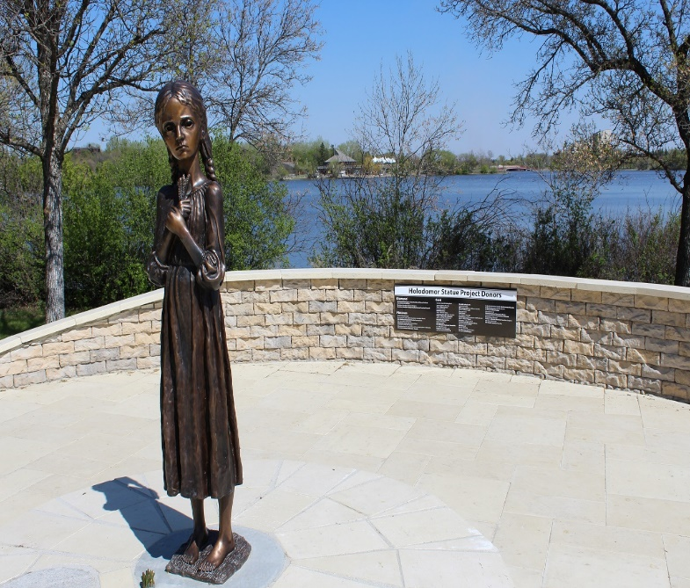
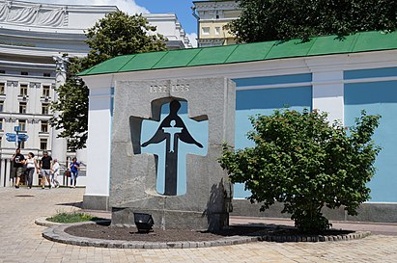

Slide 12
History provides many examples of famine that costs more human lives than the Great Irish Famine. Reliable evidence on famine casualties tends to be skimpy, but fine comparisons are not called for: enough to note that in northern China in 1877-8 a famine accounted for 9 to 13 million deaths, and in 1932-33 in the Ukraine another for probably at least 3 million (…) In this league of doom the cost of Ireland’s misfortune – about one million lives – may seem small. Measured in proportionate terms, however, the Irish famine’s toll exceeded these others”

Slide 13
November - the eve of Samhain. Ghosts walked the roads – not the souls of the dead, but real people dying. (…) the roadworks hadn’t opened. No help of any kind came from the government. Our three gold coins were gone, with the guts of the winter ahead of us

Slide 14
They trooped the passage and opened the door, noticing a man near an oven who was dressed in shirt rags and was
looking insanely, with his upper eyelids raised high and piercing glare at the newcomers. There was blood everywhere
– on the bench was a killed child terribly mutilated.
– The man lit a fire on the very fore part of an oven and in a smoke-filled house is cooking food on a pan chewing something
and holding a knife in his hand.
– One of the men who entered after the first one shrieked:
– He has killed his child and is frying it! He’s gone mad.

Slide 15
“(…)they appear to be empty. No smoke, no people, no life, nichts. Absolutely nothing. Just this accursed white.”
“Animals?”
“No, nothing. There is nothing but snow—nothing but white snow—nichts ausser diesem verdammten Schnee. And white sky.”

Slide 16
They walked around it, over it, as if it wasn’t there. I stopped—I felt I had to stop—and people scowled and told me to get out of their way, to keep moving, that they’d be late for work. I couldn’t understand their coldness, their indifference, their inhumanity”.

Slide 17
These missions carried out typical consulate functions but they also acted as undercover agencies for the Polish intelligence services. Their employees gathered invaluable information during their numerous journeys across Ukraine. The exchange of information with foreign diplomats, especially those representing Italy and Germany, added to the picture. Information collected through various channels reached the Polish authorities in the form of reports. Polish elites’ perception of events in the USSR was also affected by Biuletyn Wschodni

Slide 18
“The snow had been flattened by their footsteps and it was stained a dark brown. They espied, half covered in a snowdrift, a battered head attached to a disemboweled torso. The head had once belonged to a young woman, a blonde, with long eyelashes—which might have fluttered in the breeze if they had not been sprinkled with blood—and a long thin nose and tight mouth. The arms, legs, breasts, and buttocks were missing and the abdominal cavity lay open and mangled before them. Two crows were pulling at sinews and picking excitedly at the blue intestines. They flew away after von Mecklenburg waved his hands.
“Cannibals,” Golub said, so quietly as to be almost inaudible. “They’re not scavengers. They’re cannibals.” He surveyed what remained of the woman’s body with glassy eyes. “I think she was still alive. I think they tore her to pieces while she was still alive. I thought I heard groans.” He placed one hand on his forehead. “It was this woman.” He shook his head in disbelief and suppressed a sob”.

Slide 19
Thank you for your attention

Slide 20
The Literary Image of the Famine as a Form of Transmitting Historical Memory and Aesthetic Emotions (in Ukrainian, Irish, Irish- American and Ukrainian-American fiction)
Author: Oksana Weretiuk,
University of Rzeszow, Poland

Slide 21
The treatment of the Irish people by the British Government during the famine has been described as genocide – race murder. The British Government has been accused, and not only by the Irish, of wishing to exterminate the Irish people, as Cromwell wished to ‘extirpate’ them, and as Hitler wished to exterminate the Jews

