Slide 1
A MAJOR MINORITY LANGUAGE: IRISH AND THE QUESTION OF LINGUISTIC NATIONALISM
Diarmuid Ó Giolláin
University of Notre Dame

Slide 2
Celtic Languages

Slide 3
Phases of the Irish Literary Language
Archaic Irish 600 to 700 AD
Classical Old Irish 700 to 900 AD
Middle Irish 900 to 1200 AD
Classical Irish 1200-1650 AD

Slide 4
Copy of Priscian’s Institutiones Grammaticae with 3478 glosses in Old Irish. Probably written in Ireland around 850-851, brought to the continent between 855 and 863, and arrived around 888 in Sankt-Gallen

Slide 5
Irish Language c. 1500

Slide 6
Irish Font commissioned by Elizabeth I (1570)

Slide 7
St. Anthony’s College, Leuven (Louvain)

Slide 8
St. Patrick & St. Brigid, Saint Isidore’s, Rome

Slide 9
Geoffrey Keating (Seathrún Céitinn)
Foras Feasa ar Éirinn
(history of Ireland completed in 1634/35)

Slide 10
Print and Scribal Transmission
1700 – 1750: c. 9,000 printed titles published in Ireland in English, 4 in Irish
1751 – 1800: 16,000 titles in English, 19 in Irish
1800 – 1900: c. 150 in Irish.
18th and 19th centuries: c. 4,000 Irish-language manuscripts have survived.

Slide 11
Irish c. 1800

Slide 12
Irish Speakers and Total Irish Population
1821: 3.7 out of 6.8 million?
1841: 4.1 out of 8.2 million.
1851: 1.5 out of 6.55 million
1861, 1.1 out of 5.8 million
1871, 0.8 of 5.4 million

Slide 13
Douglas Hyde, “The Necessity for de-Anglicising Ireland” (1892)

Slide 14
An Ghaeltacht (official Irish-speaking districts) 1926

Slide 15
Irish-Speakers Today
The total number of persons (aged 3 and over) who could speak Irish in April 2016 was 1,761,420, representing 39.8 per cent of the population.
According to the 2011 UK Census, in Northern Ireland 184,898 (10.65%) claim to have some knowledge of Irish, of whom 104,943 (6.05%) can speak the language to varying degrees.

Slide 16
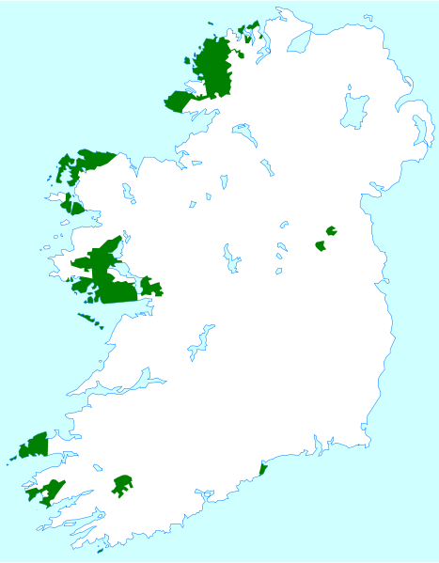
Official Gaeltacht (Irish-speaking districts) today

